Slide 1

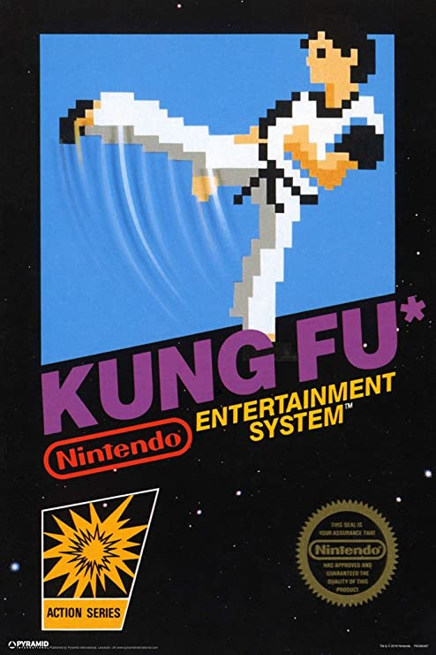
Kung Fu
Mouaz Ali

Slide 2
What is Kung Fu?
NES arcade game
Released in December 1984
Developed by Irem
Known as Spartan X in Japan
Based on Hong Kong martial arts films

Slide 3
What is TAS?
Tool-assisted speedrun
Speedrunning an emulated or modified video game
Used to create a perfect playthrough
Tools to perform impressive features in game
Completes a task while optimizing for time

Slide 4
What major tools are involved?
Emulation
Savestates
Speed control
Memory watch
I am going to use Bizhawk’s built-in TAStudio to exploit timed inputs

Slide 5
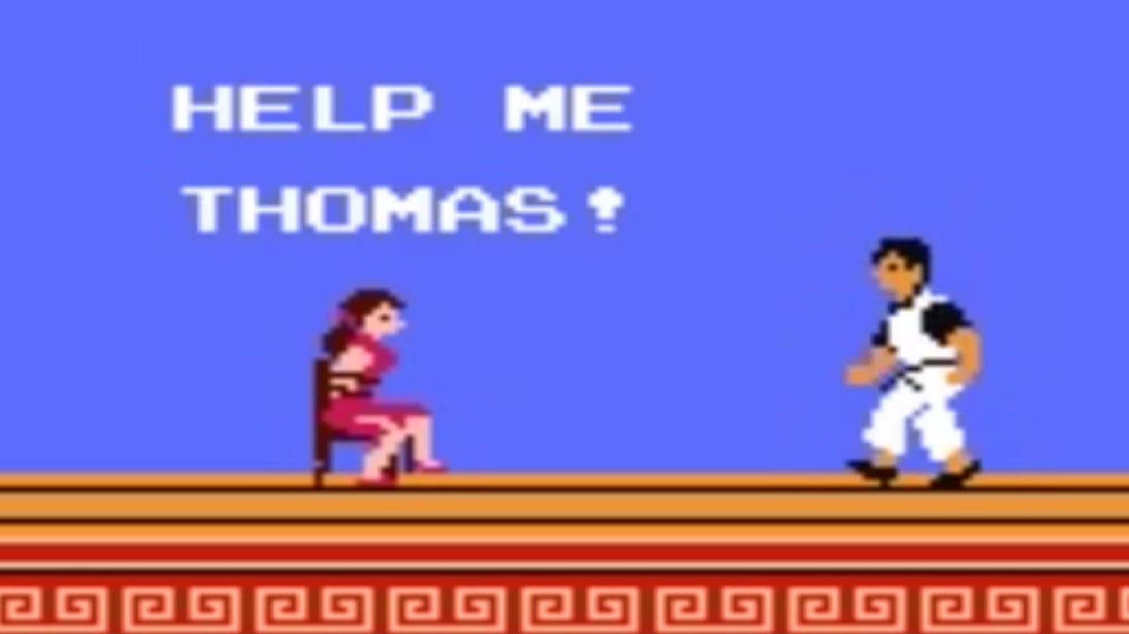
Goal
Complete the first three levels without taking any damage by using tool-assisted input

Slide 6
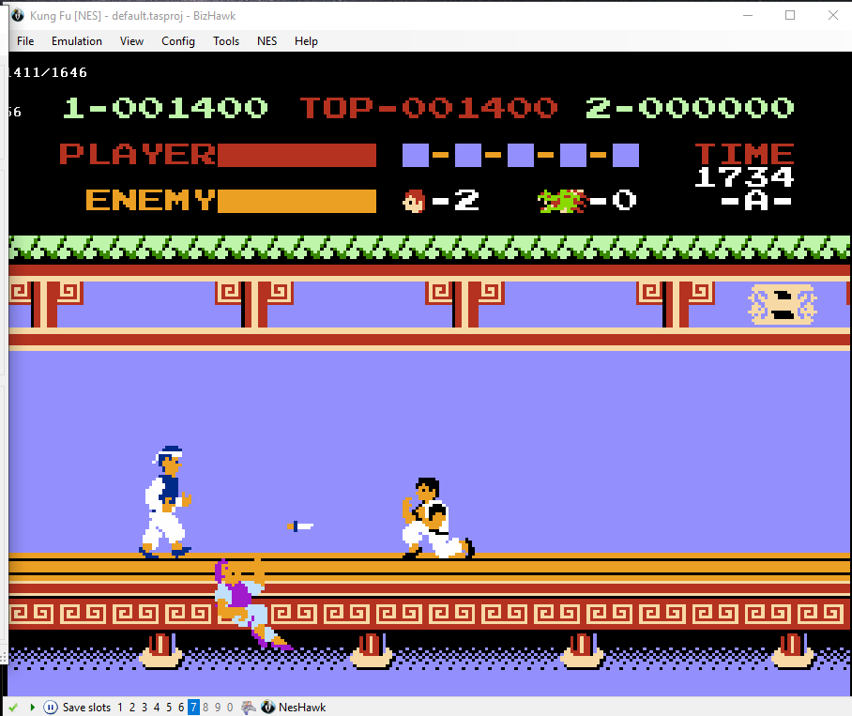
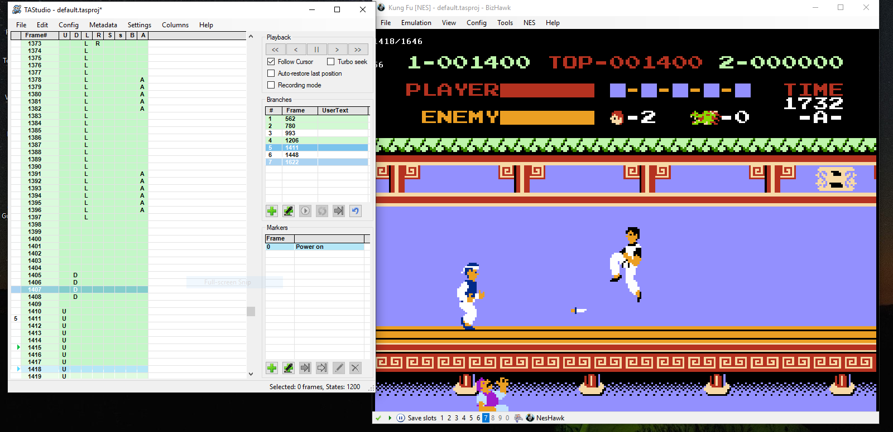
Controlling the Input
By changing the input through TAStudio, I was able to jump over the thrown object.
I got hit here with the dagger since it was too quick for me to dodge.

Slide 7

Importance of timing
One thing about changing the input is that you must be as precise as possible. By precise, I mean frame by frame because even the smallest detail can make a difference.
Thanks to the feature that lets you emulate and work on each frame in TAStudio, it made it much easier to manipulate control inputs with accuracy.

Slide 8
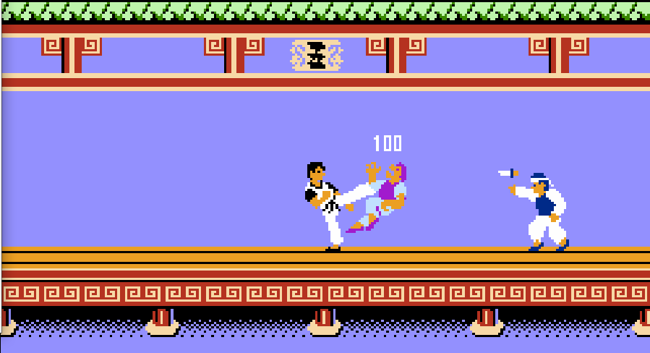
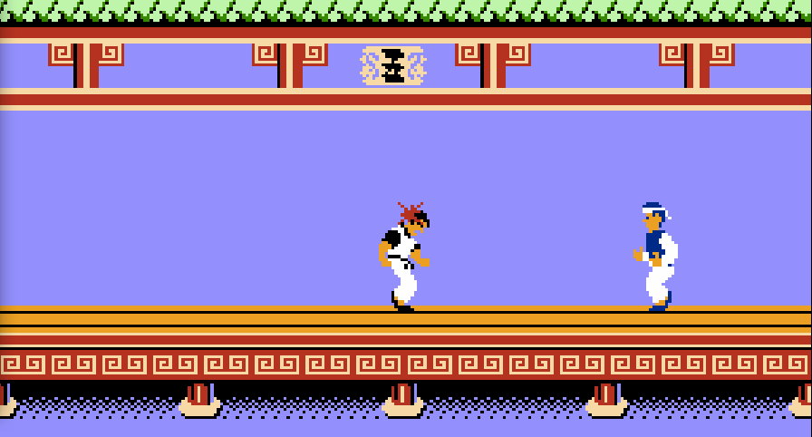
Example
As you can see below, I got hit with the dagger because I was not able to duck in time. Therefore, I used a save-state to go back and change the input frame by frame so that I could avoid taking damage by ducking earlier.

Slide 9
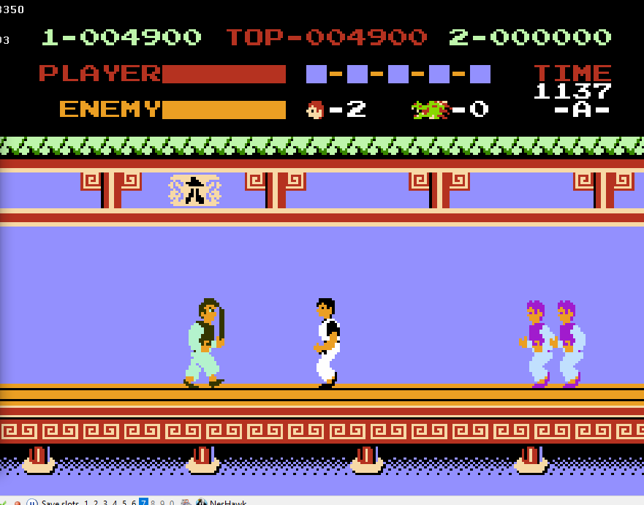
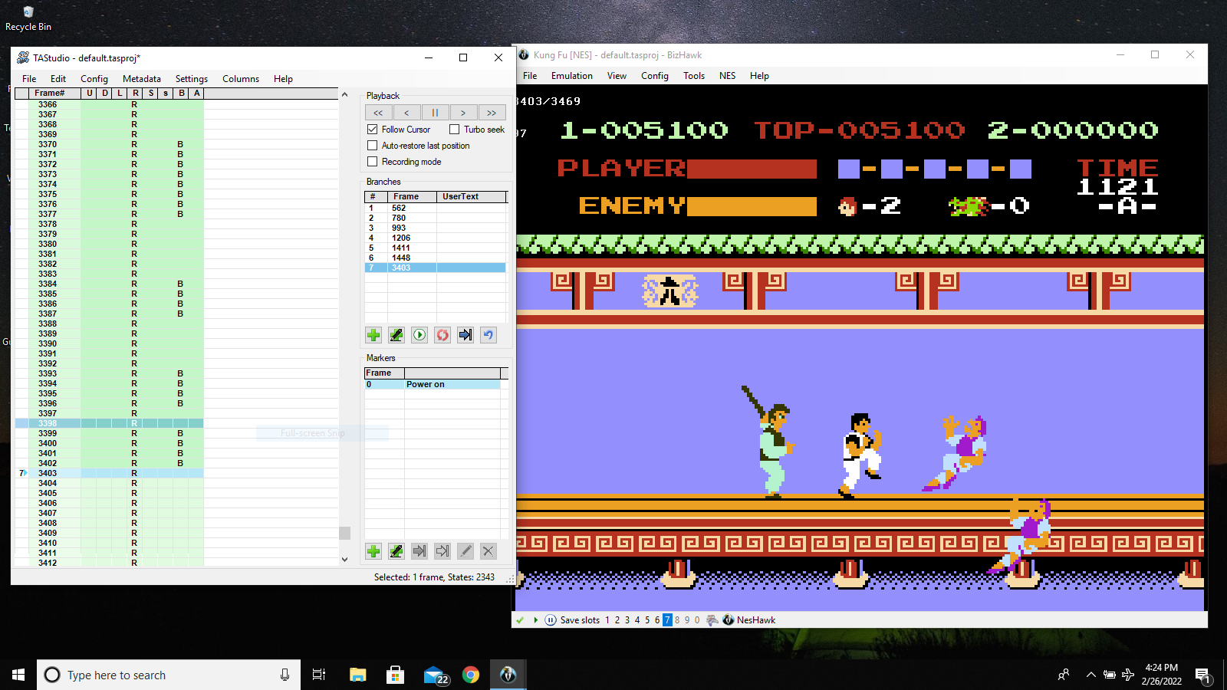
Difficult Scenarios
As you can see here, I’m stuck in a tough situation where I have the main enemy on one side and two attackers on the other. Originally, I took health damage here because it wasn’t possible to fight both sides at once.
This allowed me to quickly switch directions and defeat enemies from both sides, altering the upcoming frame.
I used a save-state to go back to a frame before the damage that I could manipulate.

Slide 10
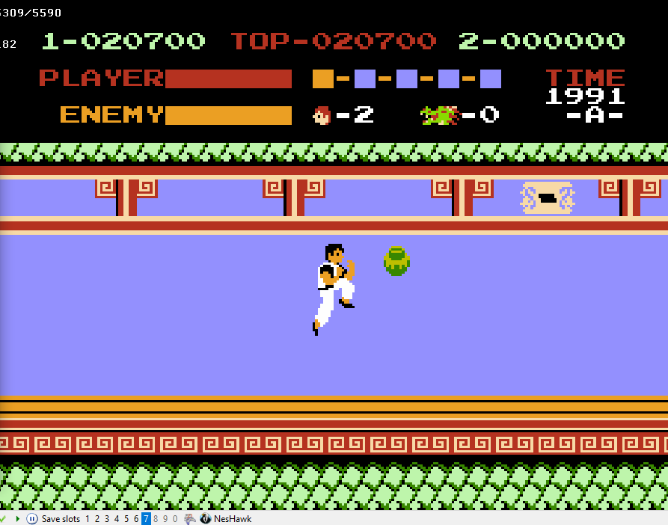
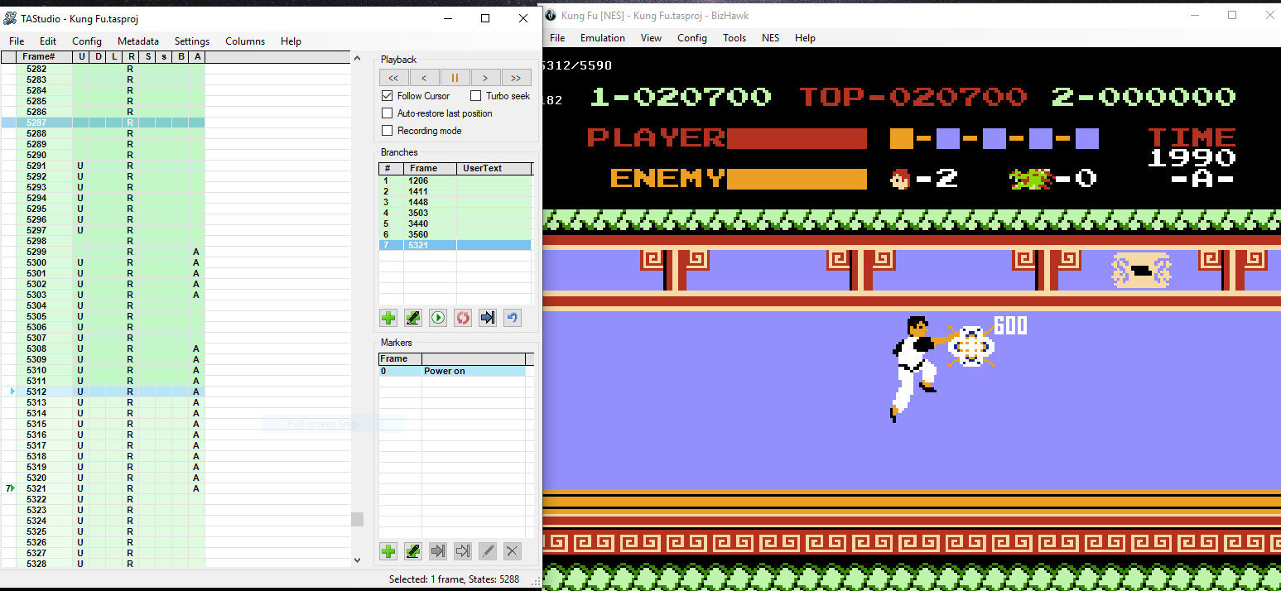
Unexpected Dangers
Here we see a snake egg about to hatch, which took away my health the first couple of times because I was not prepared for it.
I had already learned my lesson, so I changed the input to destroy the egg before it even has a chance to hatch.

